Slide 1

AtliQ Motors Project provided by codebasics
Abhimanyu Singh

Slide 2
Problem Statement
AtliQ Motors is an automotive giant from the USA specializing in electric vehicles (EV). In the last 5 years, their market share rose to 25% in electric and hybrid vehicles segment in North America. As a part of their expansion plans, they wanted to launch their bestselling models in India where their market share is less than 2%. The chief of AtliQ Motors India wanted to do a detailed market study of existing EV/Hybrid market in India before proceeding further

Slide 3
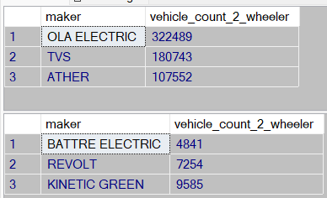
Research Questions
List the top 3 and bottom 3 makers for the fiscal years 2023 and 2024 in terms of the number of 2-wheelers sold.
TOP 3 makers
BOTTOM 3 makers

Slide 4
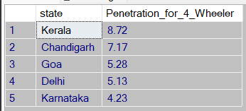
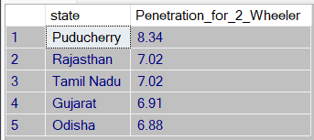
Identify the top 5 states with the highest penetration rate in 2-wheeler and 4-wheeler EV sales in FY 2024.
-- We had two seperate names for Andman & Nicobar Island so we made them one
UPDATE electric_vehicle_sales_by_state
SET state = 'Andaman & Nicobar Island'
where state = 'Andaman & Nicobar'

Slide 5
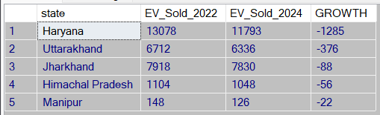
List the states with negative penetration (decline) in EV sales from 2022 to 2024

Slide 6
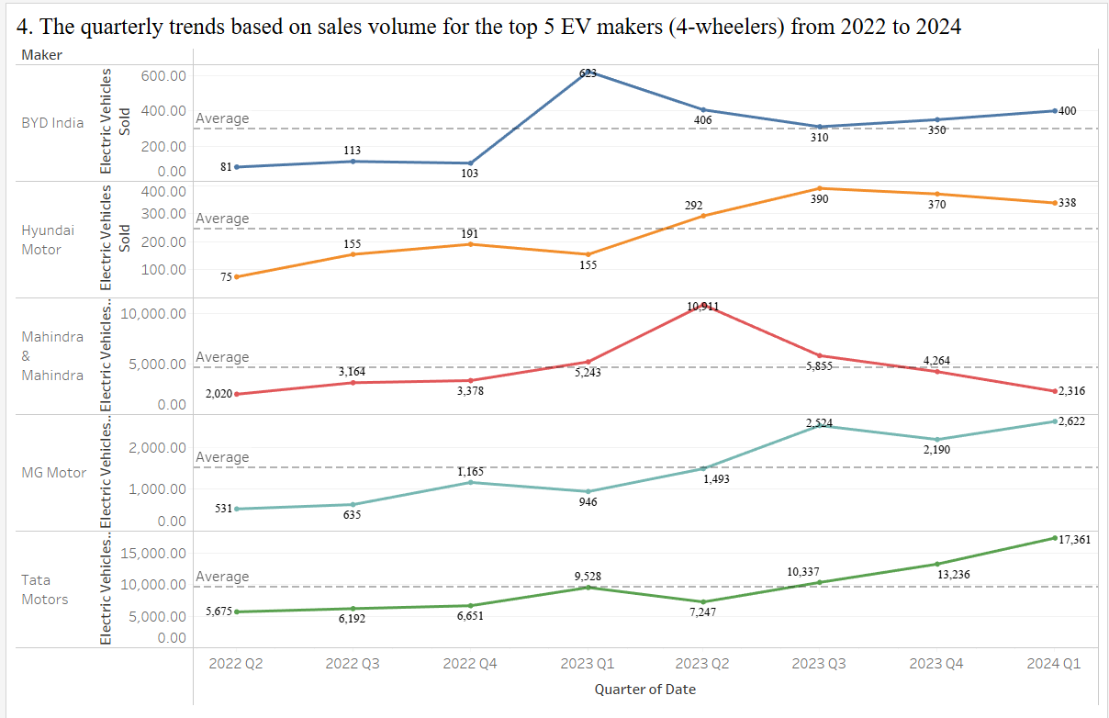
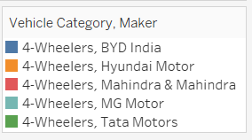
What are the quarterly trends based on sales volume for the top 5 EV makers (4-wheelers) from 2022 to 2024

Slide 7

How do the EV sales and penetration rates in Delhi compare to Karnataka for 2024

Slide 8
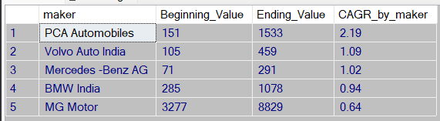
List down the compounded annual growth rate (CAGR) in 4-wheeler units for the top 5 makers from 2022 to 2024.

Slide 9
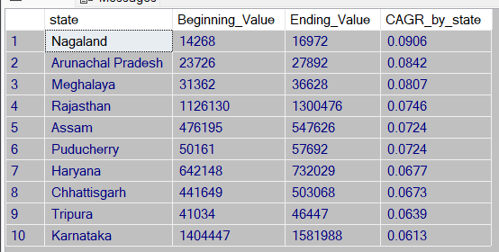
List down the top 10 states that had the highest compounded annual growth rate (CAGR) from 2022 to 2024 in total vehicles sold.

Slide 10
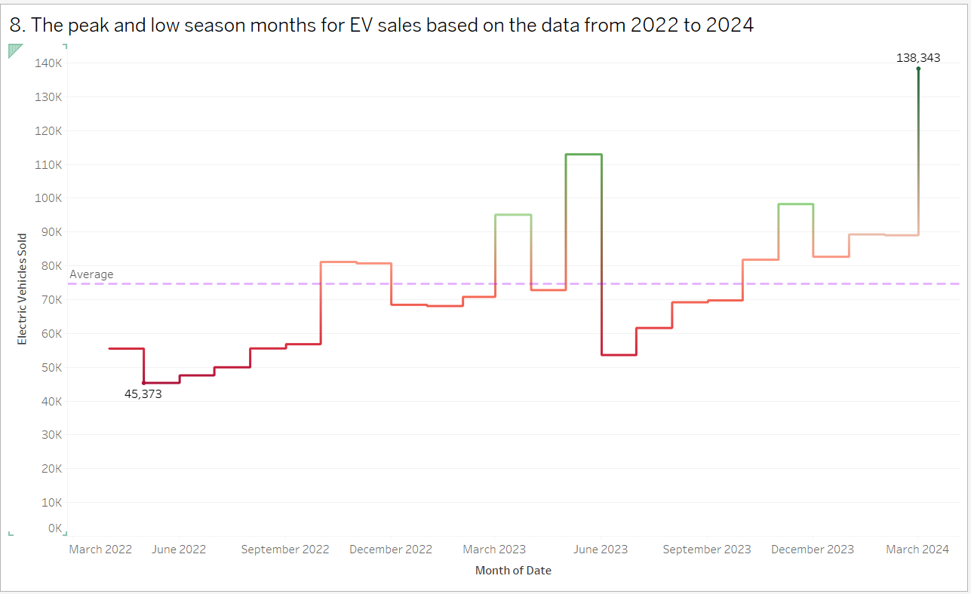

What are the peak and low season months for EV sales based on the data from 2022 to 2024?

Slide 11
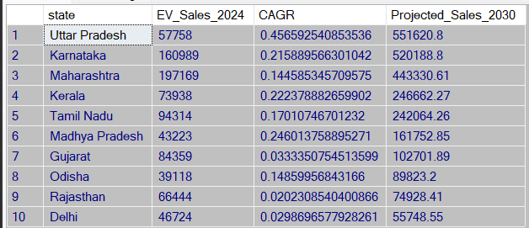
What is the projected number of EV sales (including 2-wheelers and 4- wheelers) for the top 10 states by penetration rate in 2030, based on the compounded annual growth rate (CAGR) from previous years

Slide 12
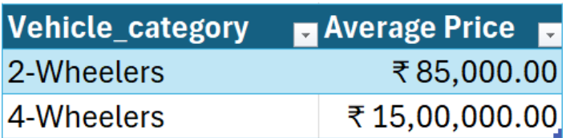
Estimate the revenue growth rate of 4-wheeler and 2-wheelers EVs in India for 2022 vs 2024 and 2023 vs 2024, assuming an average unit price.

Slide 13
Thank you

